Slide 1
Fostering SMEs through
Public Procurement
for Sustainable Development
October 2014
Sun-gu Ji
Director General, International Goods Bureau
Public Procurement Service (PPS), Korea
Notes:
Good afternoon.
I am Sun-gu Ji, Director General of International Goods Bureau at Public Procurement Service of Korea.
It is my great pleasure to join this Tenth Annual Conference of INGP.
My organization, PPS, is working together with some of you, such as Costa Rica, Chile and Peru,
and I am very glad to meet our partner institutions here, and make new friends.
Sustainable procurement has many aspects,
and we had very interesting presentations about them from distinguished speakers today.
It is my turn to bring up another important issue of supporting SMEs for sustainable development.
I would like to introduce some policy instruments that we use in Korea,
to foster SMEs through public procurement.

Slide 2
I
Public Procurement Service (PPS)
in the Korean Government
2
Notes:
I would like to begin with a brief overview of public procurement in Korea,
and the role of my organization.

Slide 3
Public Procurement in Korea
Public Procurement Service (PPS)
PPS
Central procurement agency of the Korean government
Procures goods, services and public works for all public entities
Establishes government-wide framework contracts for frequently purchased commercial products
PPS
Procurement Coverage
Use of PPS’s procurement services
Central govt. | Mandatory
Local govt. & public enterprises | Optional
PPS’s total procurement in 2013 was USD 37.9 billion
PPS (33.5%)
Korea’s PP
Total $113 billion
3
Notes:
Korea centralized a part of its public procurement, and PPS is the central procurement agency.
We procure goods, services, and public works on behalf of all public entities in Korea.
We also make framework contracts for commercial products that are commonly used by public entities.
However, it does not mean that we cover the entire public procurement in Korea.
I will briefly explain our procurement coverage.
For central government entities, it is mandatory to use PPS
above 100,000 US dollars for goods and services, and 3 million US dollars for construction works.
Local governments and public enterprises may procure on their own, but they may also choose to use PPS.
In 2013, total public procurement in Korea was 113 billion dollars. PPS’s procurement was about 38 billion dollars.
So we cover about 33% of public procurement in Korea.

Slide 4
Public Procurement Service
PPS’s Roles
In addition to procurement contracting, PPS also operates the government-wide e-Procurement system (KONEPS), stockpiles mineral commodities, and oversees the management of government properties
Procurement
Contracting
Mgmt. of
Govt.-owned
Properties
Operation of
KONEPS
Stockpiling
4
Notes:
Apart from procurement, we also have additional roles.
Firstly, we manage the national e-Procurement system called KONEPS.
Secondly, we stockpile mineral commodities to maintain balanced supply and demand,
and support the production activities in the country.
Lastly, we oversee the management of government-owed properties;
to ensure public entities use the government’s asset properly.

Slide 5
II
Fostering SMEs
in Public Procurement Market
5
Notes:
Now, let me move on to how we foster Small and Medium Enterprises though public procurement.

Slide 6
SMEs in Korea
Definition of SMEs and Contribution to Economy
Industry
Employees
Capital (or Annual Sales)
Manufacturing
Fewer than 300
Less than US$ 8 M
Construction
Fewer than 300
Less than US$ 3 M
Wholesale & Retail
Fewer than 200
(Less than US$ 20 M)
Why should the government support SMEs?
99.9% of businesses are SMEs
86.8% of employees work for SMEs
47.7% of value-added generated by SMEs
2,900 large
businesses
1.8 million large business employees
SMEs
Large
Businesses
3.3 million SMEs
13 million SME employees
6
Notes:
This slide shows the overview of SMEs in Korea.
We consider the nature of each industry, when we define SMEs.
For example, a manufacturer is considered an SME if it has fewer than 300 employees, or its capital is less than 8 million dollars.
For other industries, such as construction or retail, the definitions are different.
Like other countries, the Korean government is making hard efforts to overcome the economic downturn;
to stimulate the economy and create more jobs.
SMEs are very important economic agents for this, because our 3 million SMEs represent 99.9% of the businesses in Korea.
They make 87% of all employments, half of the value-added created in Korea.
Vigorous business activities of SMEs are critical for our economy;
so PPS is using various policy tools to foster SMEs in the public procurement market.

Slide 7
Policies to Support SMEs in Public Procurement
Public Procurement Service (PPS)
Competition among SMEs for targeted products
Priority purchasing for excellent SME products
Easier Market
Entry
Prompt payment upon delivery
Upfront payment & loans for public contracts
Cash –flow
Support
Stockpile & release of raw materials for stable production
Work efficiency and low transaction costs through end-to-end e-Procurement
Business
Efficiency
7
Notes:
We think about SME supports in three aspects.
First is to help SMEs enter the public procurement market more easily and win public contracts.
We have policy tools to give SMEs broader market opportunities for targeted industries;
as well as for excellent SME products with good quality and technology.
Second is to help SMEs with their cash-flow.
Very often, SMEs have good products but don’t do well due to financial difficulties.
We try to help their cash flow through prompt payment;
and to help them fulfill their contracts, we use upfront payment and loan programs.
Another important aspect is to help SMEs improve their business environment.
For this, we use our stockpiling program to support SMEs with their stable supply of raw materials.
Our e-Procurement system also help them work more efficiently, and save transaction costs
for doing business with the government.
Let me go further into each policy tools one by one.

Slide 8
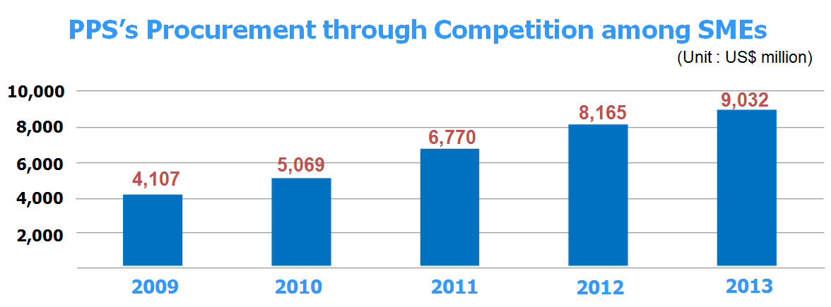
SME Policies (1) - Easier Market Entry
Competition among SMEs for Set-aside Products
Policy Instrument
Designate set-aside products to be procurement through competition among SME manufacturers
Products for Inter-SME Competition
Annually announced by Small & Medium Business Administration
207 products in 2014, including furniture, guardrails, water tanks, motors, etc.
8
Notes:
To help SMEs enter the public procurement market more easily,
The Korean government uses has an SME set-aside program for targeted products.
Each year, the Small and Medium Business Administration of Korea selects the set-aside products,
to be purchased from SMEs only.
However, to keep the principle of competition, we conduct competitive bidding among SMEs,
rather than direct contracting.
There is an important requirement to join this competition. The SME has to be the manufacturer of the product.
As of this year, 207 products are set aside for SME competition, including furniture, guardrails, water tanks, and motors.
As you see on this slide, our purchases through this SME competition has constantly increased,
and it amounted to 9 billion US dollars last year.
Some countries have similar SME set-aside policies for small contracts.
Korea’s approach is different in that we target specific industries,
where SMEs have competitiveness and large potentials.

Slide 9
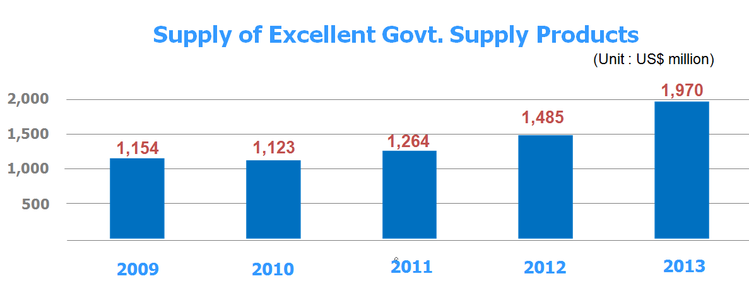
SME Policies (1) - Easier Market Entry
Excellent Government Supply Products
Policy Instrument
PPS annually certifies Excellent Government Supply Products
Certified products are available at KONEPS Online Shopping Mall for direct ordering
Excellent Government Supply Products
Approx. 1,070 SME manufactured products with good performance, technology and quality
9
Notes:
Very often, SMEs have new products with outstanding technology,
butt it takes time until they develop a stable market in the private sector.
In the mean time, the public procurement market should provide an initial market for such products.
For this purpose, PPS has a program for SME products with excellent technology and quality.
Each year, we select and certify “Excellent Government Supply Products”.
Certified products become available at KONEPS Online Shopping Mall,
and any public entity can order the products online without bidding.
Currently there are 1,000 Excellent Products in 8 categories, including machinery, IT, and electronics.
Once selected, the Excellent Product can maintain the status for 2 years,
and it can extend up to 6 years, depending on their performance.
To ensure that the selection is objective and fair,
We invite over 700 experts outside of PPS to evaluate the products.
As you see on the slide, the total public sector purchase of the Excellent Products is nearly 2 billion US dollars,
helping these outstanding SME products grow in the private sector.

Slide 10
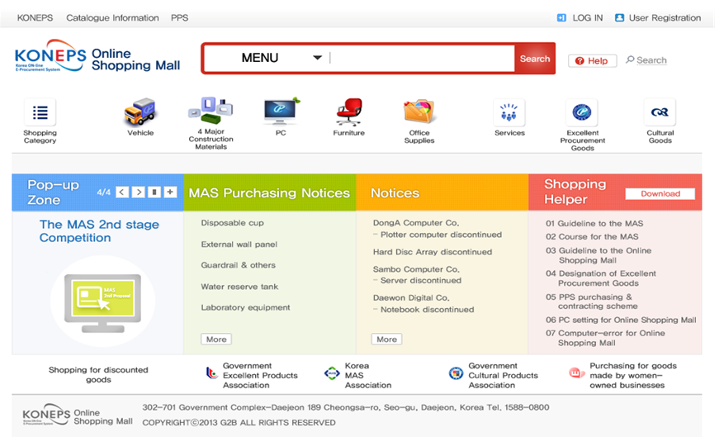
SME Policies (1) - Easier Market Entry
Promotion of Excellent Govt. Supply Products at KONEPS Online Shopping Mall
Excellent Govt. Supply Products
10
Notes:
This is the website of our Online Shopping Mall within our e-Procurement System KONEPS.
We have a separate section for Excellent Government Supply Products,
so that public entities can find and order them easily.

Slide 11
SME Policies (2) – Cash-flow Support
Prompt Payment upon Delivery (Surrogate Payment)
Policy Instrument
Korean law provides for payment within 5-7 days from product delivery
PPS makes payment within 4 hours upon product delivery
* PPS pays the supplier from its revolving fund, and get reimbursed later from the end user
PPS
PPS
Availability
“Payment upon Delivery” is available for
Payment upon
Delivery
Reimbursement
Unit-price (framework) contracts
All orders against PPS’s Unit Price Contracts
③
Supplier
End User
(Public Entity)
Lump Sum Contracts
(Large businesses) under USD 100,000
(SMEs) under USD 500,000
Product
Delivery
11
Notes:
Now I am moving to the financial support programs for SMEs.
When the economy’s down, SMEs face problems with their cash flow.
The best support that the government can give is prompt payment upon their contract delivery.
In many countries, suppliers have to wait a month to get the payment, or sometimes even one year.
In Korea, the payment is generally made within 5 to 7 days.
However, for contracts made by PPS, the suppliers receive the payment within 4 hours,
the same day as they deliver the contracted products.
Suppliers can get the same day payment for all unit-price contracts, and lump sum contracts under 100,000 dollars.
SME suppliers can get the same day payment for lump sum contracts under 500,000 dollars.
Such prompt payment is possible, because PPS manages a revolving fund from the revenue from our services.
We pay the contractor from our revolving fund first, and get reimbursement from the end-user later.

Slide 12
SME Policies (2) – Cash-flow Support
Upfront Payment
Policy Instrument
Procuring entities pay up to 70% of contract amount upfront, for the expenses for contract performance
End User
(Public Entity)
Agreement on
Upfront Payment
Requirements
PPS
Suppliers must submit guarantee
Request for
Upfront Payment
Confirmation of
Guarantee
Contracts eligible for upfront payment are :
Goods / Public works
Contract over USD 30,000
Supplier
Surety
Company
Services
Contract over USD 5,000
Guarantee
Application
12
Notes:
If an SME was awarded a contract, but needs financial resources to carry out the contract,
we also make upfront payment up to 70% of the contract amount.
This upfront payment is available for contracts over 30,000 dollars for goods and public works,
and contracts over 5,000 dollars for services.
There are two requirements for upfront payment.
First, the end-user entity should agree with PPS for the upfront payment.
Second, the supplier must submit a guarantee from a surety company.
PPS also cooperates with surety companies to allow suppliers to get the guarantee at a low rate.

Slide 13
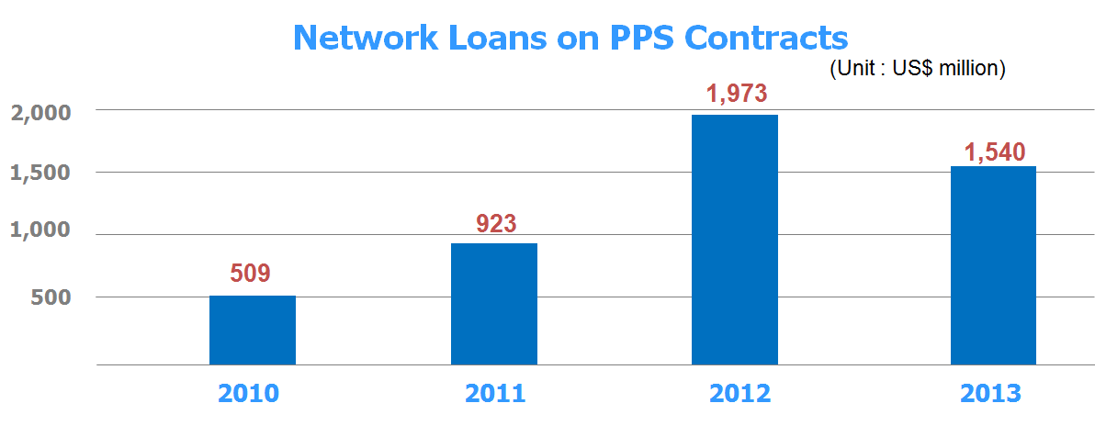
SME Policies (2) – Cash-flow Support
Network Loan
Policy Instrument
PPS set up the “network loan” program with commercial banks and surety companies
Suppliers may get loans from partner banks for carrying out PPS contracts at Low interest rate
(Network Loan Partners) PPS, Korea Federation of Small and Medium Business, Korea Technology Finance Corp., Industrial Bank of Korea, Shinhan Bank, and Hana Bank
13
Notes:
We also have a program called “Network Loan”.
In order to make loans available for suppliers with a PPS contract,
we created a partnership with the SME Federation, public financial institutions and commercial banks.
Based on the agreement, commercial banks offer loans to suppliers to fulfill their contracts,
at low interest rate and guarantee premium.
Our SME suppliers find this loan very helpful.
As you see on the chart, more and more suppliers are using this loan program to fulfill their contracts.

Slide 14
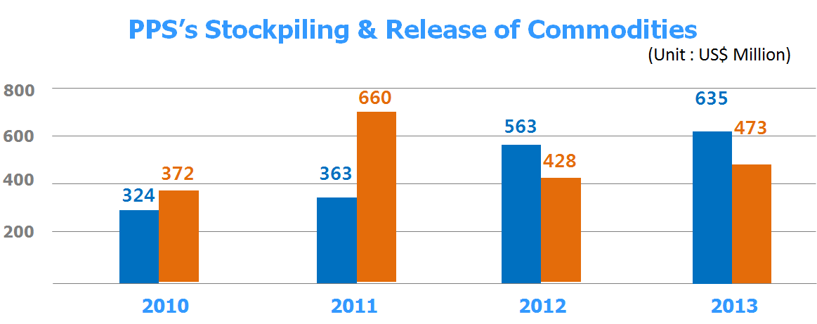
SME Policies (3) – Business Efficiency
Stockpile & Release of Raw Materials
Policy Instrument
PPS stockpiles mineral commodities, to maintain stable supply, stable price level, and to support the government’s industrial policies
[ Commodities Stockpiled by PPS ]
(Non-ferrous Metals) Copper, aluminum, zinc, nickel, lead, tin
(Rare Metals) Silicon, manganese, cobalt, vanadium, indium, lithium, tantalum, etc.
At times of supply disruption, PPS releases its stock at market price
Helps SMEs continue their production activities
Purchase
Release
14
Notes:
I am moving to the third aspect of SME support. That is, to help SMEs do business more effectively.
Korea has scarce natural resources, and many suppliers depend on imports for raw materials.
To help to maintain stable supply of raw materials,
PPS runs a stockpiling program for important mineral commodities.
They include raw materials for fundamental infrastructure, such as copper, aluminum and lead,
and rare metals for technology products such as silicon and lithium.
When there is a global supply disruption, we release our stock at market price,
to help the industry continue their production.
We release our stock to both large businesses and SMEs,
But because SMEs are more vulnerable to the market disruptions,
SMEs benefit more from our release program.
We are gradually increasing our stockpiling program, as you see on the chart,
to support our indutry and to prepare for national emergencies.

Slide 15
SME Policies (3) – Business Efficiency
Work Efficiency and Transaction Cost Savings via e-Procurement
Policy Instrument
End-to-end e-Procurement throughout tender notice, bidding, contracting and payment through Korea Online e-Procurement System (KONEPS)
Annually saves transaction costs of USD 8 billion (USD 6.6 billion for bidders)
e-Bidding via KONEPS
Contract
Delivery
Ministry of Strategy
& Finance
Industry
Associations
Public Buyer
National Tax Office
KONEPS
Credit Rating
Company
Construction
Authorities
Surety Companies
e-Bid
Korea Financial
Telecommunications
& Clearings Institute
Certification-
Related agencies
Supplier
15
Notes:
Lastly, an efficient and easy procurement process is a important support for SMEs.
Public procurement requires intensive paperwork for the suppliers,
and it costs time, money, and labor.
In Korea, we accomplished a major innovation using a national e-Procurement system called KONEPS.
It processes the entire procurement cycle online,
throughout tender notice, bidding, contracting and payment.
It collects information on supplier information and their qualifications from 150 databases,
so that the suppliers can easily participate in biddings in their office,
with minimal paperwork.
e-Procurement through KONEPS is saving 8 billion US dollars annually,
and the private sector’s savings amount to 6.6 billion dollars.
SMEs can find business opportunities more easily,
and grow more competitive from the savings in time, costs and labor.

Slide 16
THANK YOU
Notes:
In finishing my presentation, I would like to stress two things.
First of all, SME policies should give support and incentives, not just a privileged status.
Therefore, We should target at specific areas where SMEs are competitive,
or outstanding products that contributes to the technology development.
Secondly, awarding more contracts to SMEs is not the only option.
There are other areas, such as financial support and creating efficient business environment.
Using a specialized procurement agency, available funds, or partnership with financial institutions,
You could create an environment where SMEs can cope better with financial difficulties,
and work more effectively at low costs.
Thank you very much.

